Slide 1
Theory of Automata Universal Turing Machine
Dr. Sabina Akhtar

Slide 2
Revision

Slide 3
Encoding
An encoding of TM, <M>, (or, for that matter, an encoding of any object) Is a string that fully describes that TM, in the sense that a machine that emulates M need only read that string to know everything it needs to know about M. ¹
Example: Binary encoding scheme for TM

Slide 4
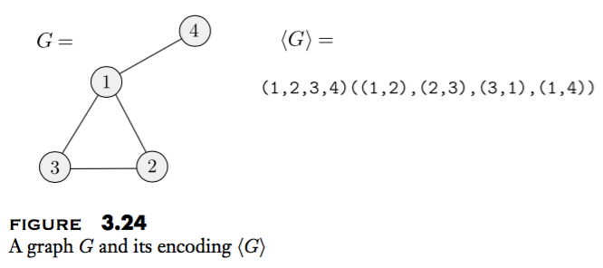
Example

Slide 5
TM encoding
Many encoding schemes for Turing machines.
They all must have the following properties:
Given a TM M, there is some encoding <M> of M using that scheme.
There is a machine that can emulate any Turing machine by reading its encoding. We call this machine the "emulator."
If x and y are both encodings of Turing machines, then x cannot be a proper prefix of y.

Slide 6
Universal turing machine, Why?

Slide 7
A limitation of Turing Machines:
Turing Machines are “hardwired”
they execute
only one program
Real Computers are re-programmable

Slide 8
Universal TM
Universal Turing machine, U, is a Turing machine that can simulate an arbitrary Turing machine on arbitrary input.
Its achieves this by reading both the encoding of the machine to be simulated as well as the input string.

Slide 9
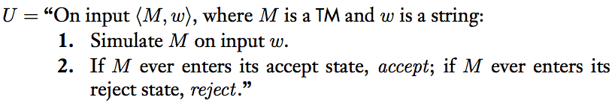
Universal Turing machine

Slide 10
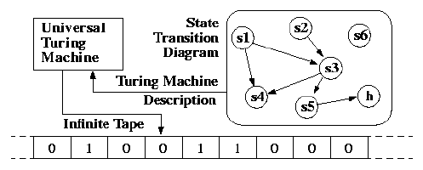
Universal Turing Machine

Slide 11
Universal TM
Input of Universal Turing Machine:
Description of transitions of M
Input string of M

Slide 12
Tape 1
Encoding of M
Universal
Turing
Machine
Tape 2
Input string of M
Tape 3
State of M

Slide 13
Example
Tape 1
Encoding of M
We describe Turing machine
as a string of symbols:
We encode M as a string of symbols

Slide 14
Alphabet Encoding
Symbols:
Encoding:

Slide 15
State Encoding
States:
Encoding:
Head Move Encoding
Move:
Encoding:

Slide 16
Transition Encoding
Transition:
Encoding:
separator

Slide 17
Turing Machine Encoding
Transitions:
Encoding:
separator

Slide 18
Tape 1 contents of Universal Turing Machine:
binary encoding
of the simulated machine M
Tape 1

Slide 19
A Turing Machine is described
with a binary string of 0’s and 1’s
Therefore:
The set of Turing machines
forms a language:
Each string of this language is
the binary encoding of a Turing Machine

Slide 20
Computers and Turing Machines
A computer can simulate a TM.
A TM can simulate a Computer

Slide 21
Simulating a TM by a Computer
Given a TM M we must write a program that acts like M.
One aspect of M is finite control.
only a finite number of states and a finite number of transition rules,
the computer can use a table of transitions which it looks up to determine each move.
The tape symbols can be encoded as character strings of a fixed length, since there are only a finite number of tape symbols.

Slide 22
What the does computer lack?

Slide 23
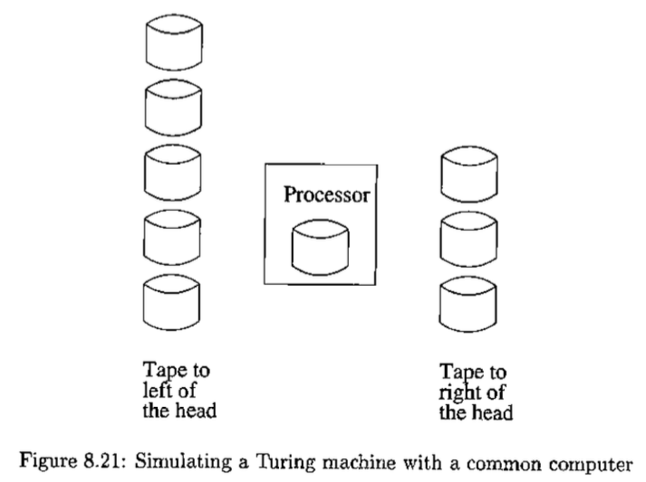

Slide 24
Simulating a Computer by a TM
a typical computer operates as
storage of a computer consists of an indefinitely long sequence of words, each with an address
The program is stored in some words of the memory
each instruction involves a limited (finite) number of words
operations such as addition are restricted to occur in registers

Slide 25
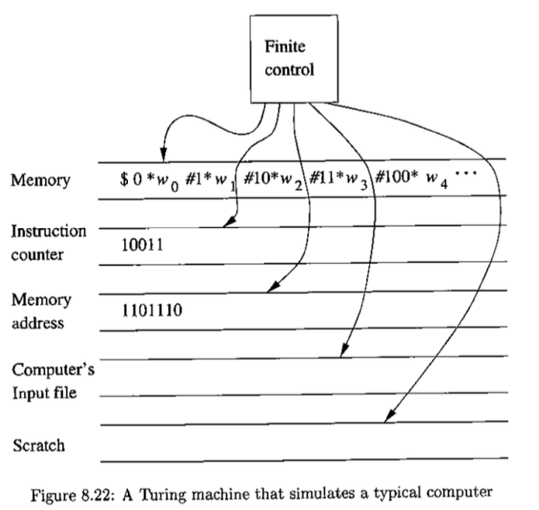

Slide 26
Simulation
Tape 1: Represents the memory of the computer.
Tape 2: Contains one integer representing the instruction counter.
Tape 3: Holds a memory address or the contents of that adress.
Tape 4: Holds the simulated input to the computer, since the computer must read its input from a file.
Tape 5: Is used to insert new words on tape 1 or to extend the size

Slide 27
Instruction cycle of the computer on TM
Search the first tape for an address that matches the instruction number of tape 2.
Mark the position of the instruction, using a second track on the first tape.
The first few bits of an instruction word represent the action to be taken and the remaining bits code one or more adresses that are involved in the action.
Copy the adresse(s) to tape 3 and get the content of this adresses onto tape 3 if necessary.
Execute the appropriate instruction.
After performing the instruction, and determining that the instruction is not a jump, add 1 to the instruction pointer on tape 2 and begin the instruction cycle again.

Slide 28
A copy instruction
Fetch the content of the first address on tape 3 then get the second address.
Find the second address on tape 1 and copy the content of tape 3 to the proper place.
If the destination address do not appear on tape 1 or if the word is to small for the new result so change the avaible space with the following shifting-over procedure:
Copy, onto tape 5, the entire nonblank tape to the right of where the new value goes.
Write the new value at the proper location.
Recopy the scratch tape onto tape 1, immediately to the right of the new value.

Slide 29
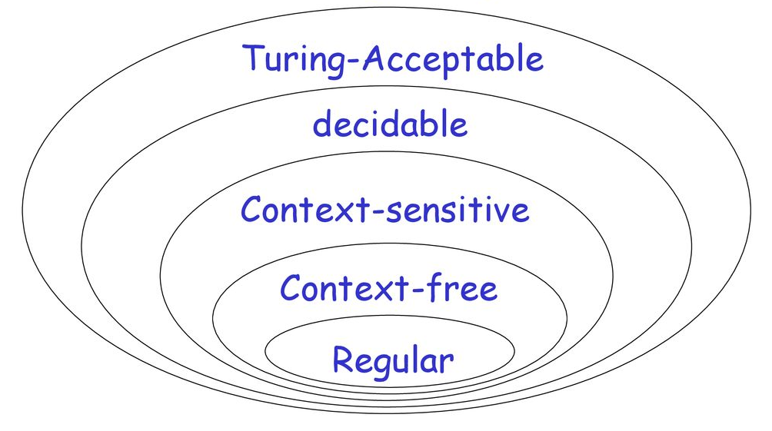
Chomsky’s hierarchy

Slide 31
References
Introduction to the Theory of Computation, 3rd Edition by Michael Sipser

